Slide 1
EzPlay
By the Bug Slayers
Christopher Ledford, Michael Fuentes, and Emirhan Tektas

Slide 2

The General Idea
Project F
All-in-One gaming platform
Optimization is the main goal
Focused on gaming with friends

Slide 3




What Makes it Different?
Project F

Slide 4

Differentiating Features
Project F
Deals Tracker
View the best deals across various storefronts
Be aware of current and upcoming promotions

Slide 5
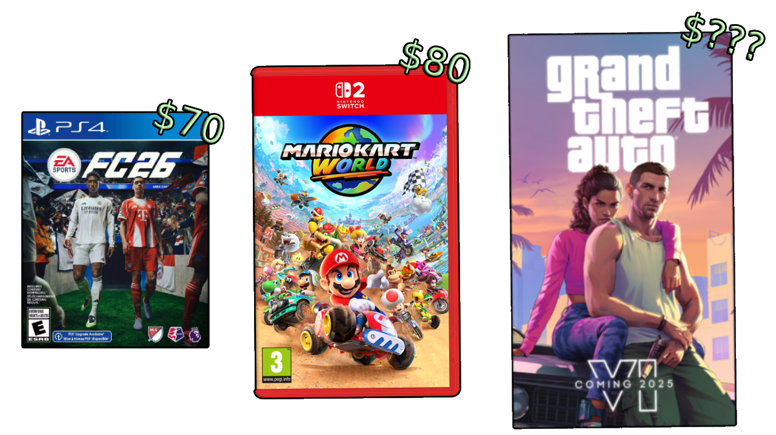
Differentiating Features
Project F

Slide 6


Differentiating Features
Project F
Lightweight Installation
Minimize and limit RAM/CPU usage
Pick and choose what features to install

Slide 7


Differentiating Features
Project F

Slide 8


Differentiating Features
Project F
Hybrid Gaming Model
Play games locally for Best Performance!
Or use cloud gaming when installation is not possible
Multiplayer is available for cloud gaming

Slide 9


Differentiating Features
Project F
Engage With Friends
Chat with friends in a call
Experience interactive apps
Clip your favorite moments together
Notes:
Chat with friends in a call system designed to run while gaming
Experience interactive apps like shareable whiteboards, puzzles, and minigames
Clip your funniest, worst, or stupidest moments together

Slide 10
Thank You for your Support
– The Bug Slayers Team

